Slide 1
FISH270
Lecture 15

Slide 2
What Do Hormones Do?

Slide 3
What Do Hormones Do?
A single hormone can exert a variety of effects
Example: T₃ and T₄ stimulate metabolism, promote growth, and increase heart rate
Several different hormones may affect the same aspect of physiology
Example: Insulin, glucagon, and epinephrine all influence glucose levels in the blood

Slide 4
What Do Hormones Do?
Hormones coordinate the activities of cells in three areas
Development growth and reproduction
Response to environmental challenges
Maintenance of homeostasis

Slide 5
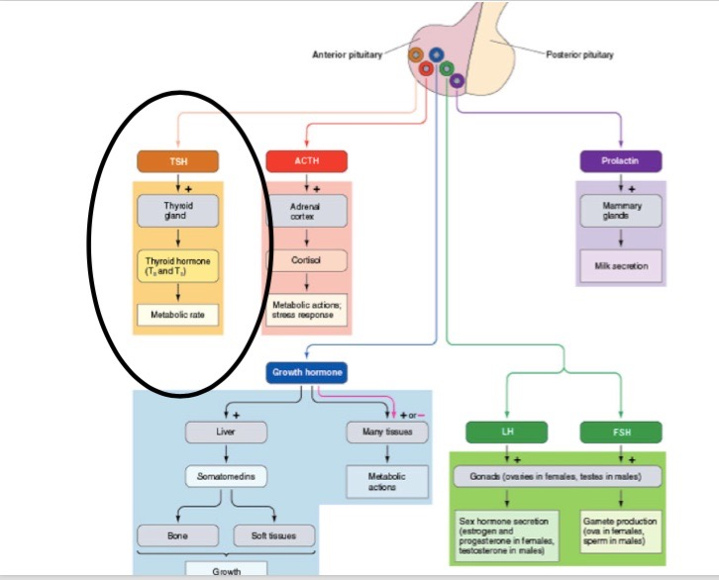

Slide 6
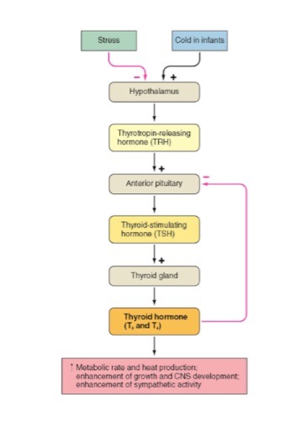

Slide 7
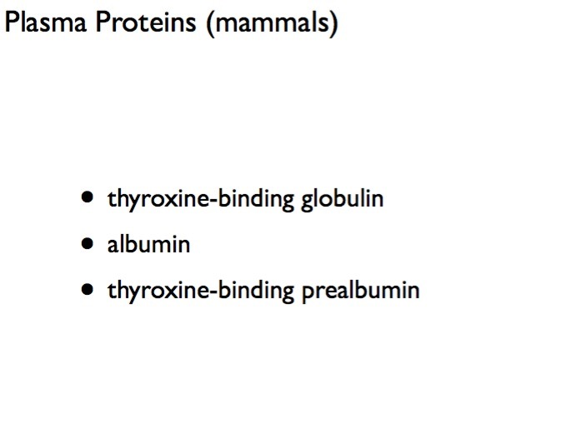

Slide 8
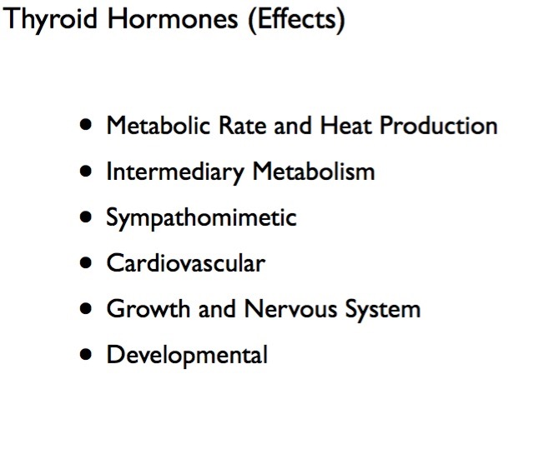

Slide 9
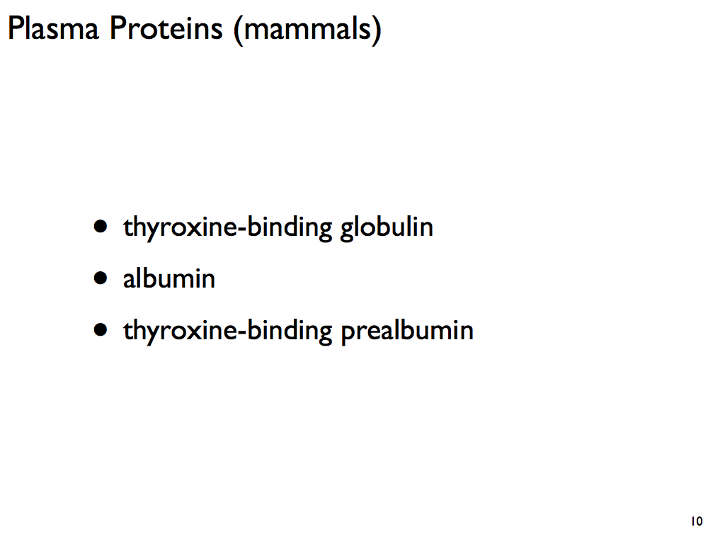

Slide 10
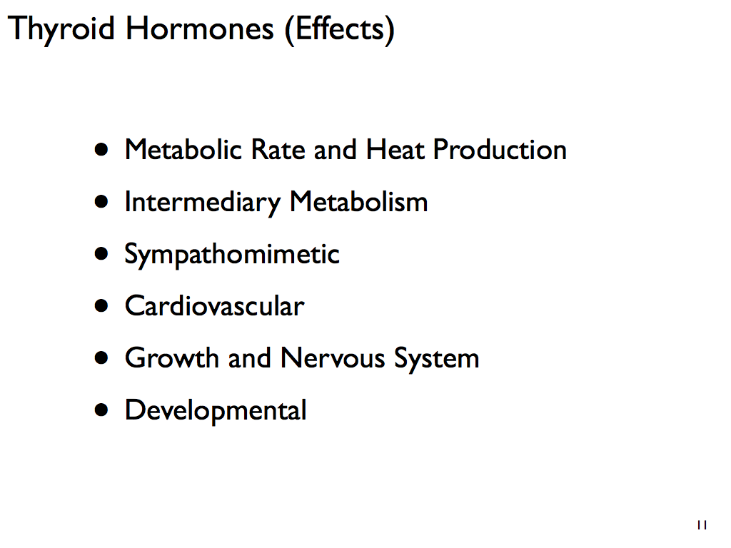

Slide 11
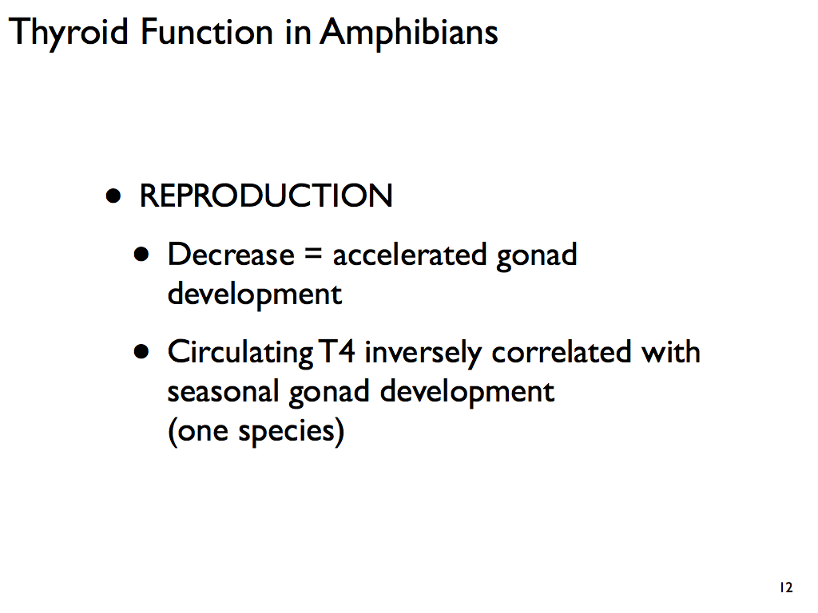

Slide 12
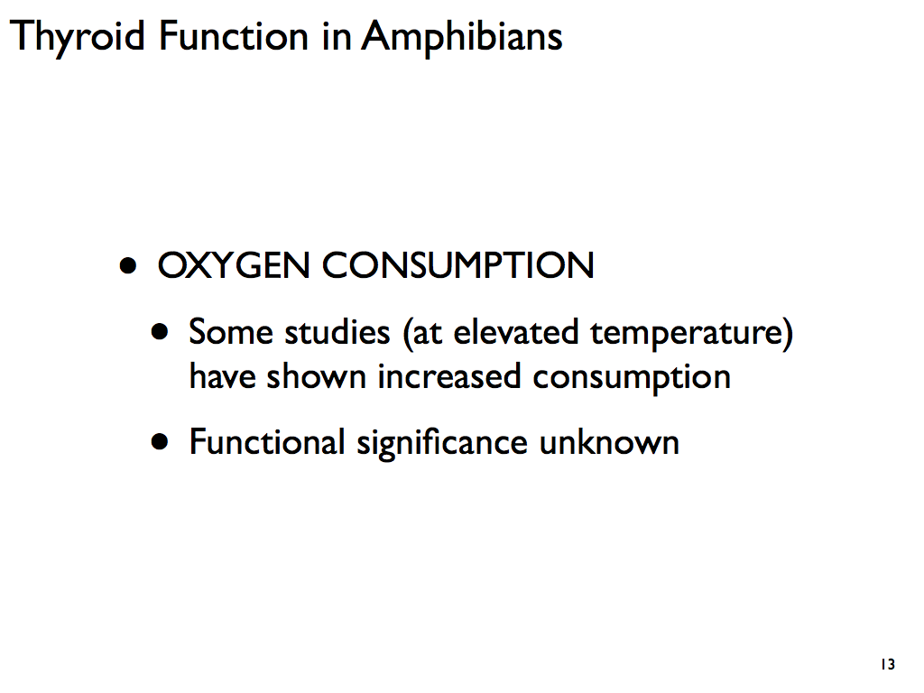

Slide 13
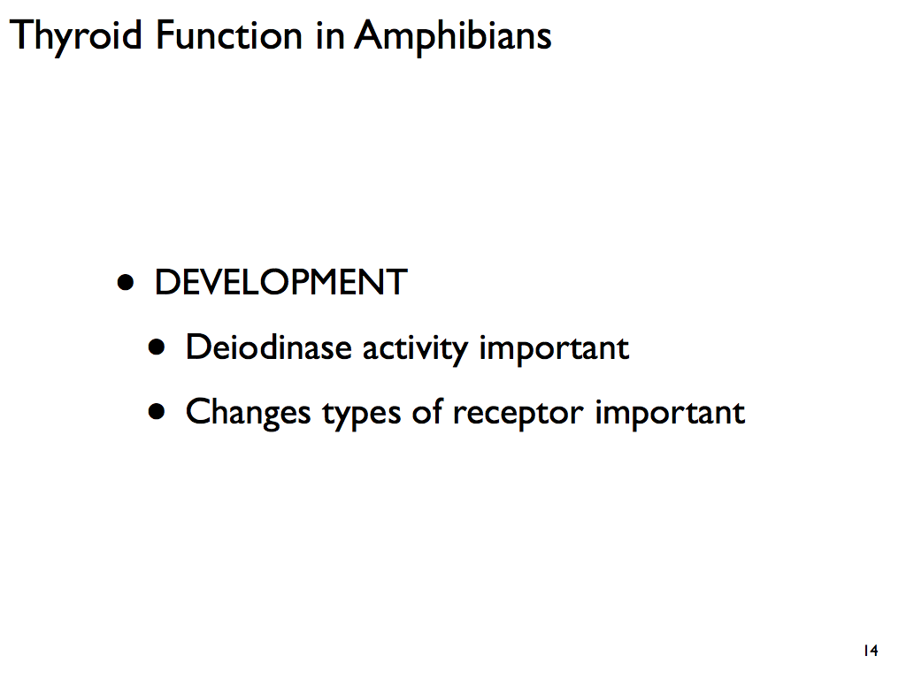

Slide 14
Hormones Direct Growth and Development
Metamorphosis in insects and amphibians is one example of how hormones regulate growth and development
Metamorphosis is the process in which an insect or amphibian will change from a larvae to adult
The thyroid hormone triiodothyronine (T₃) is responsible for most of the changes observed in this metamorphosis
T₃ is produced in response to signals from the brain

Slide 15
T₃’s Role in Amphibian Metamorphosis
In juvenile amphibians, cells respond to increased levels of T₃ in one of three ways:
By growing and forming new structures, such as legs
They may die, as in cells that form the tadpole’s tail
They may change structure and function
For example, changes in existing cells cause a tadpole’s long intestine, specialized for digesting plant material, to change into an adult’s short intestine, specialized for digesting insects and other prey

Slide 16
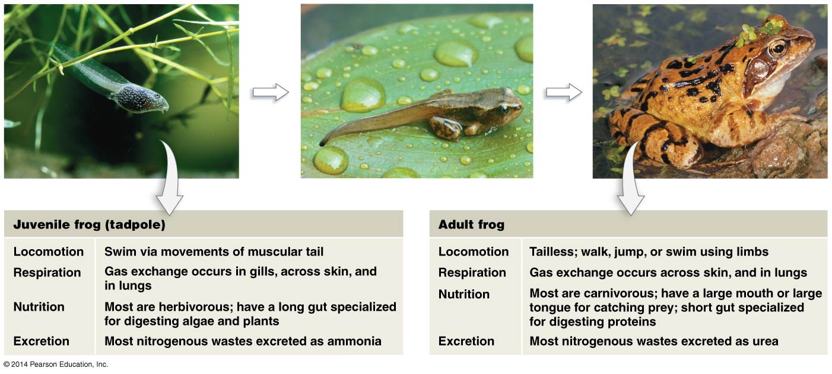
Figure 49.5
T₃
T₃
Notes:
Figure 49.5 Amphibian Metamorphosis Is a Continuous Process.

Slide 17
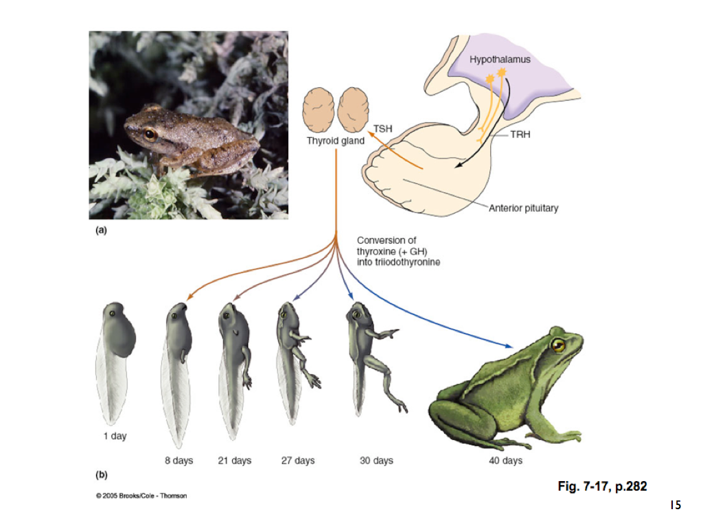

Slide 18
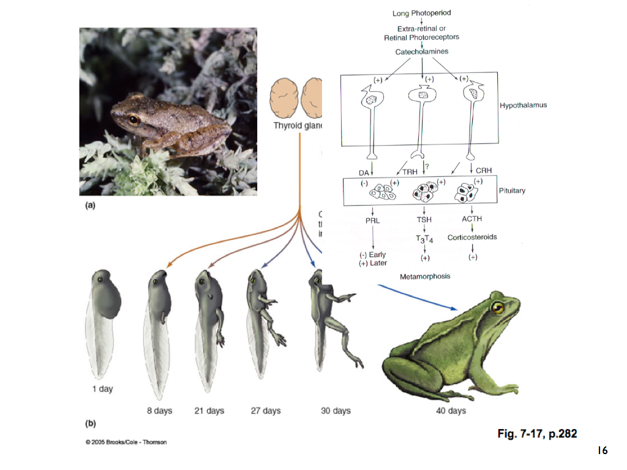

Slide 19
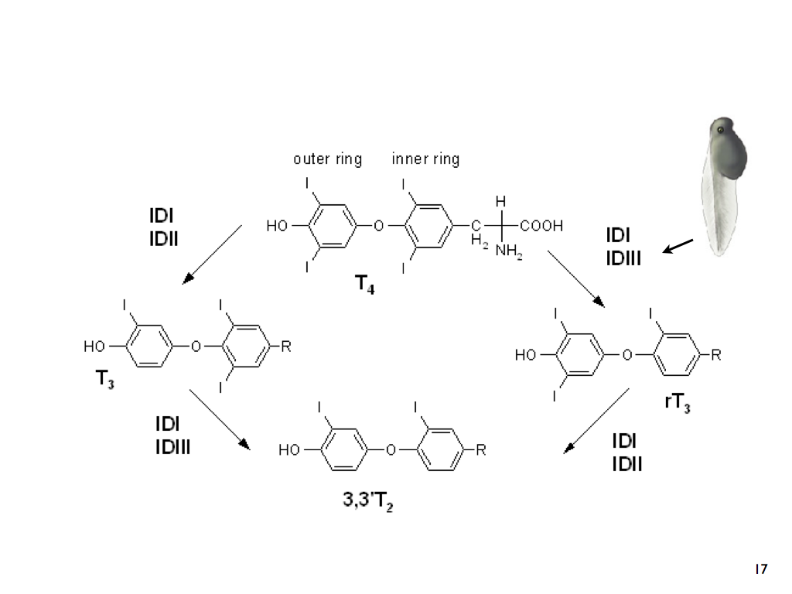

Slide 20
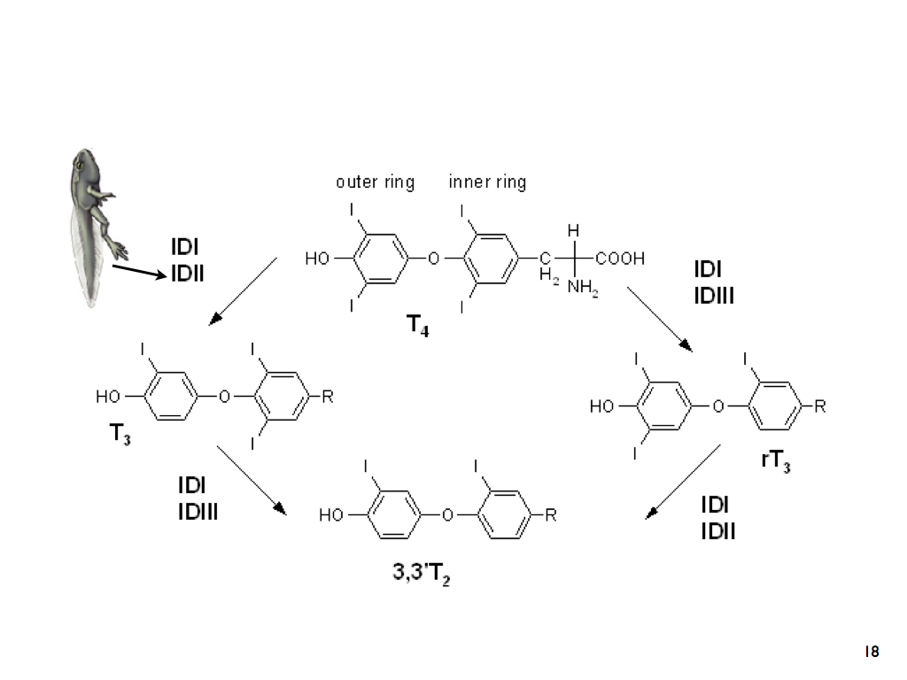

Slide 21
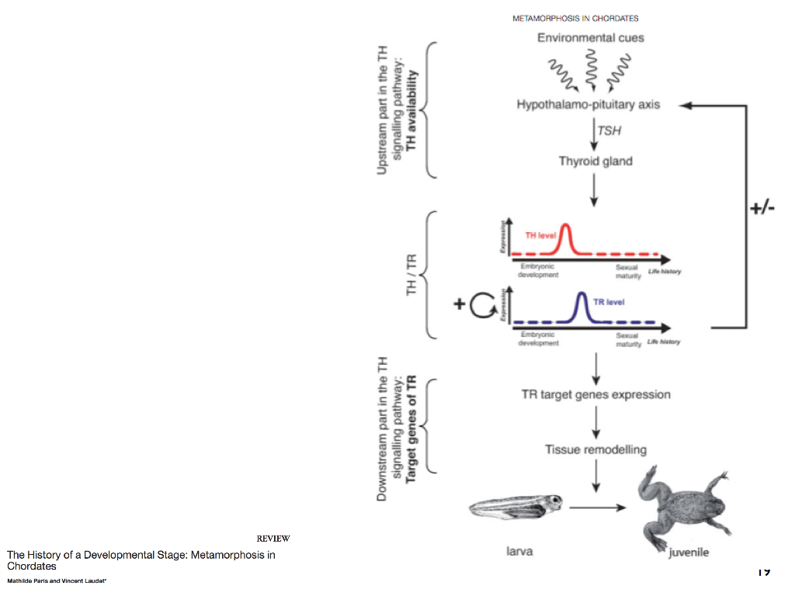

Slide 22


Slide 23
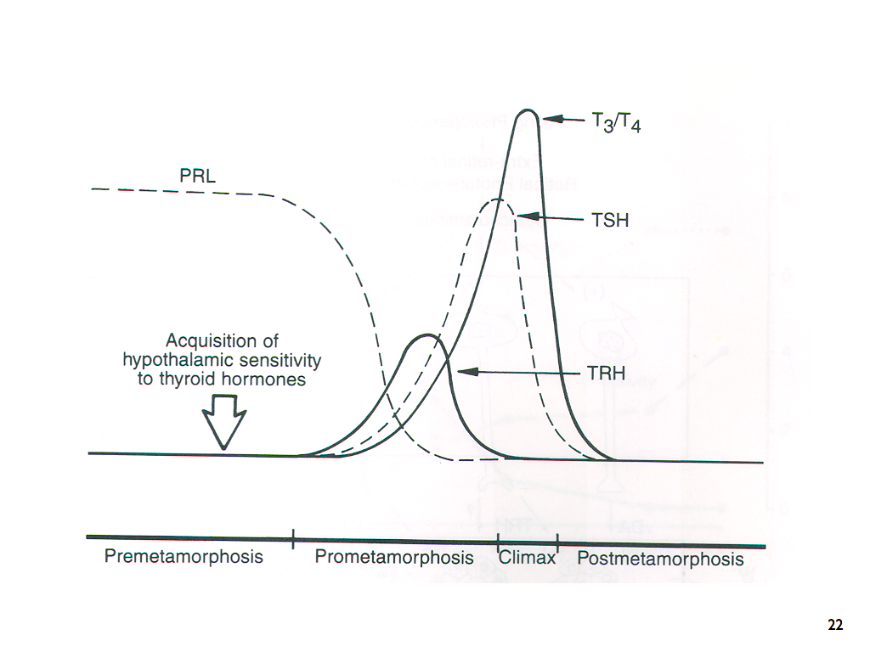

Slide 24
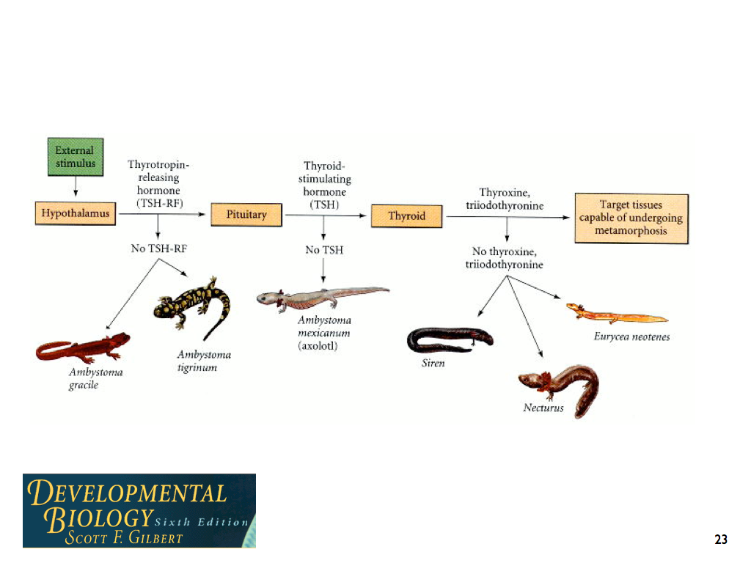

Slide 25
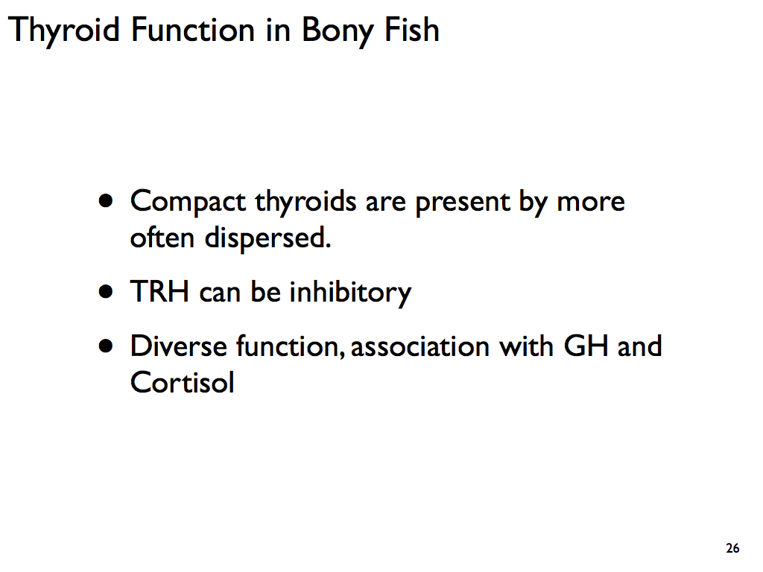

Slide 26
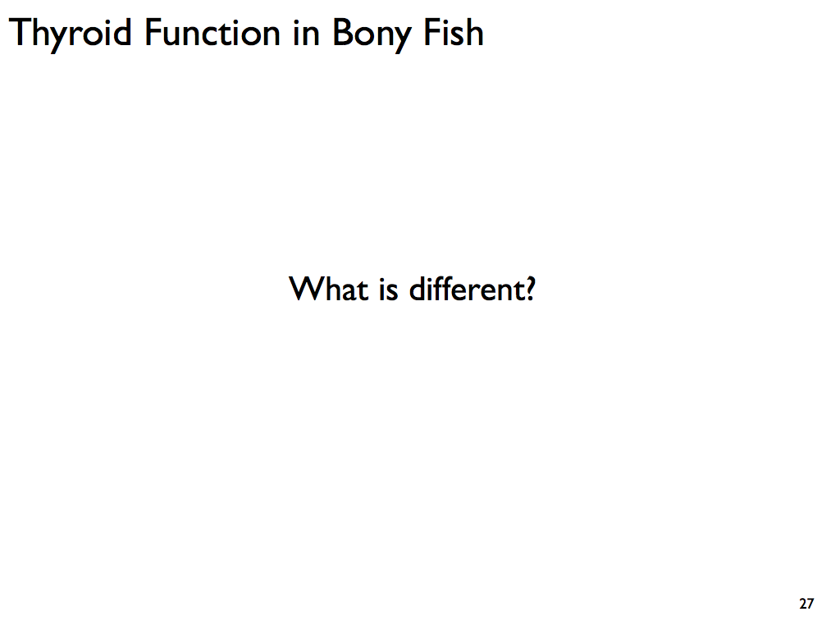

Slide 27
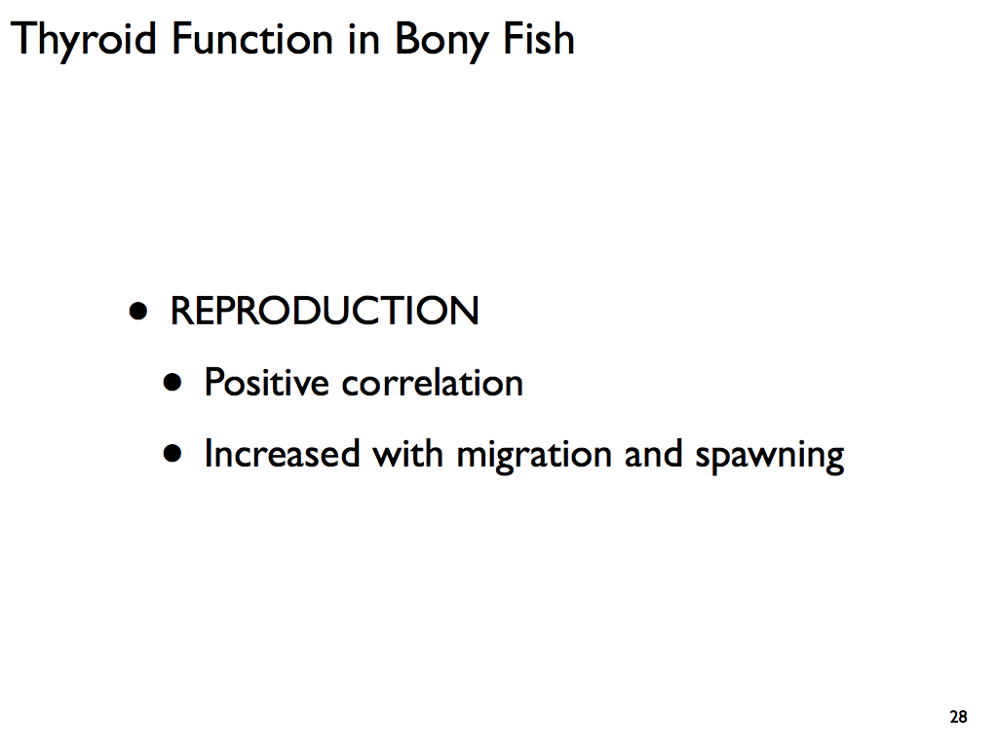

Slide 28
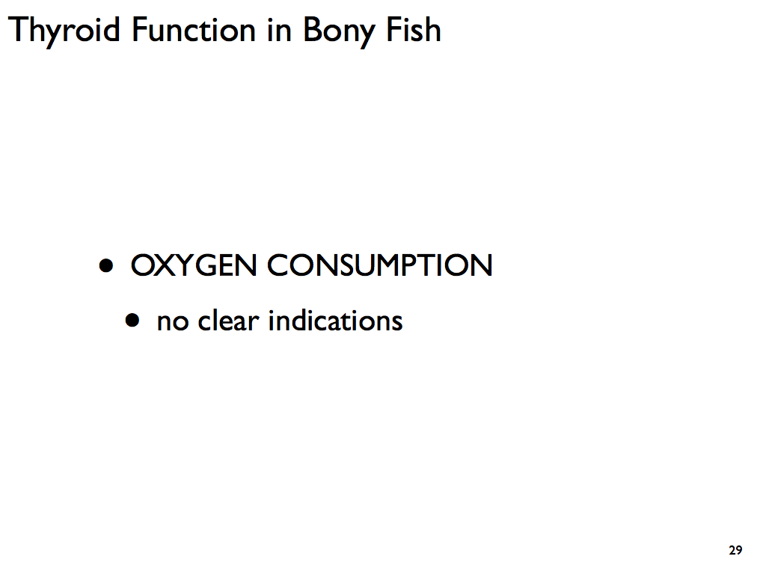

Slide 29
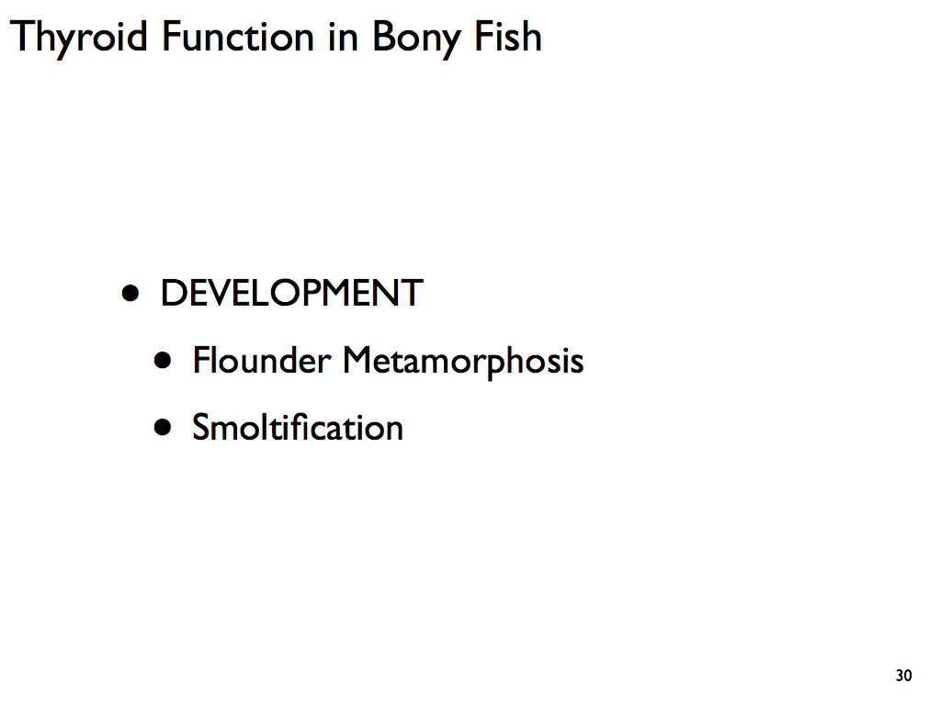

Slide 30
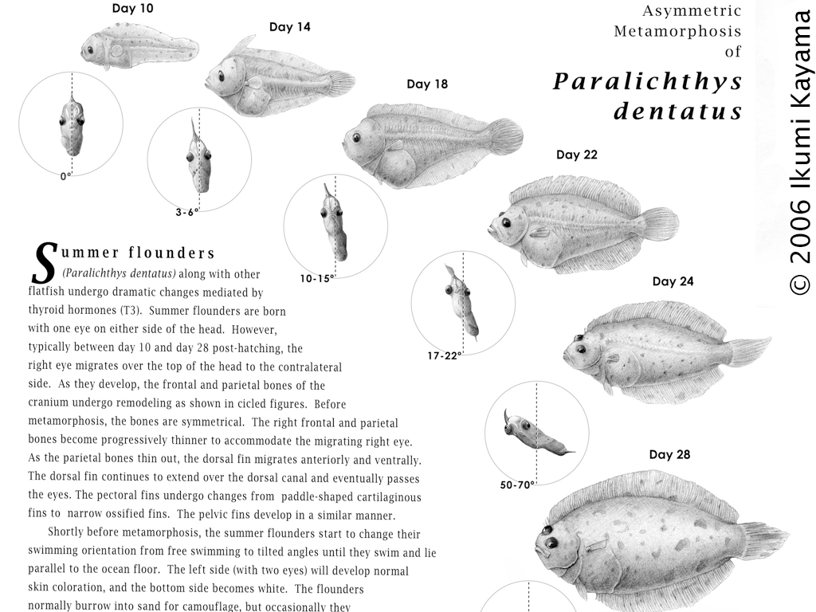

Slide 31
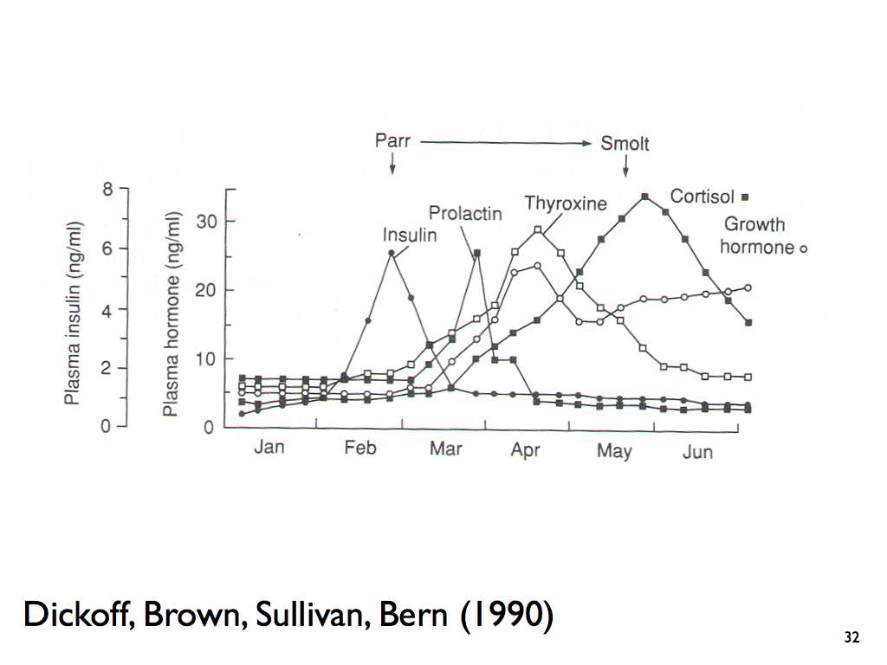

Slide 32
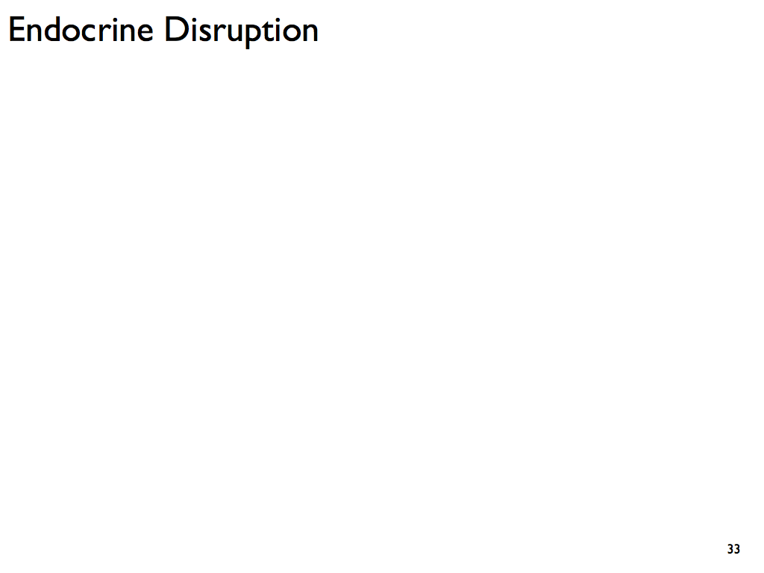

Slide 33
Hormone Disruptors
Chemicals that disrupt the action of hormones are termed endocrine disruptors
Many of the disruptors are xenoestrogens
These chemicals bind to estrogen receptors and cause the estrogen-like effects
This affects the physiology or behavior of the animal
Other examples of endocrine disruptors:
The herbicide atrazine can cause reproductive abnormalities
Bisphenol (BPA) can cause abnormal development of the brain and reproductive tissue

Slide 34
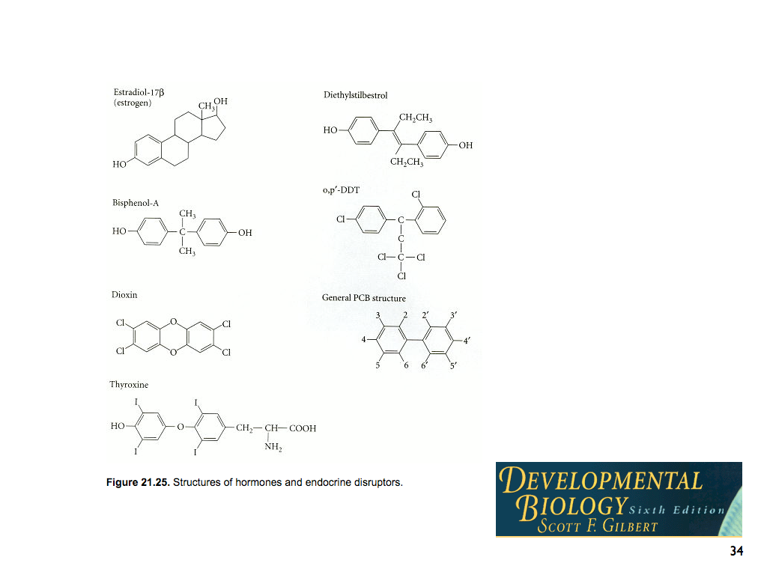

Slide 36
How Do Hormones Coordinate Responses to Stressors?
The following slides provide several examples focused on the homeostatic action of hormones.

Slide 37
Short-Term and Long-Term Responses to Stress
In a dangerous situation, hormones regulate both the short-term and long-term responses
The short-term reaction—the fight-or-flight response—is triggered by the sympathetic nervous system
The sympathetic nerves stimulate the adrenal gland to release epinephrine, also known as adrenaline

Slide 38
Short-Term and Long-Term Responses to Stress
Early studies of long-term stress in humans suggested a role for the hormone cortisol, which is produced in the adrenal gland
The primary role of cortisol during prolonged stress is to ensure the continued availability of glucose for use by the brain
Cortisol is referred to as a glucocorticoid because of its importance in regulating blood glucose

Slide 39
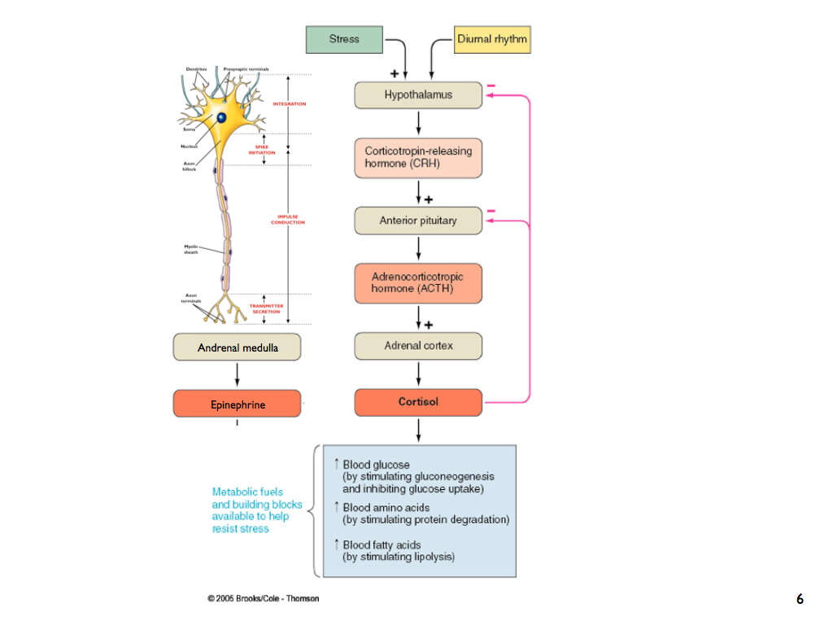

Slide 40
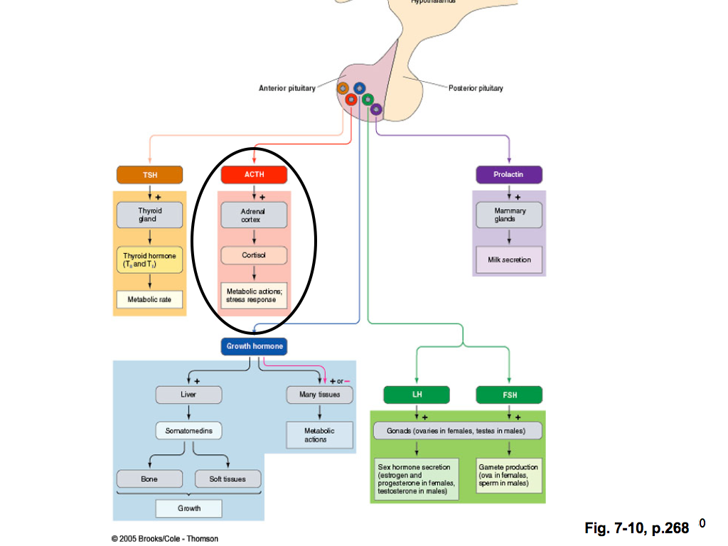

Slide 41
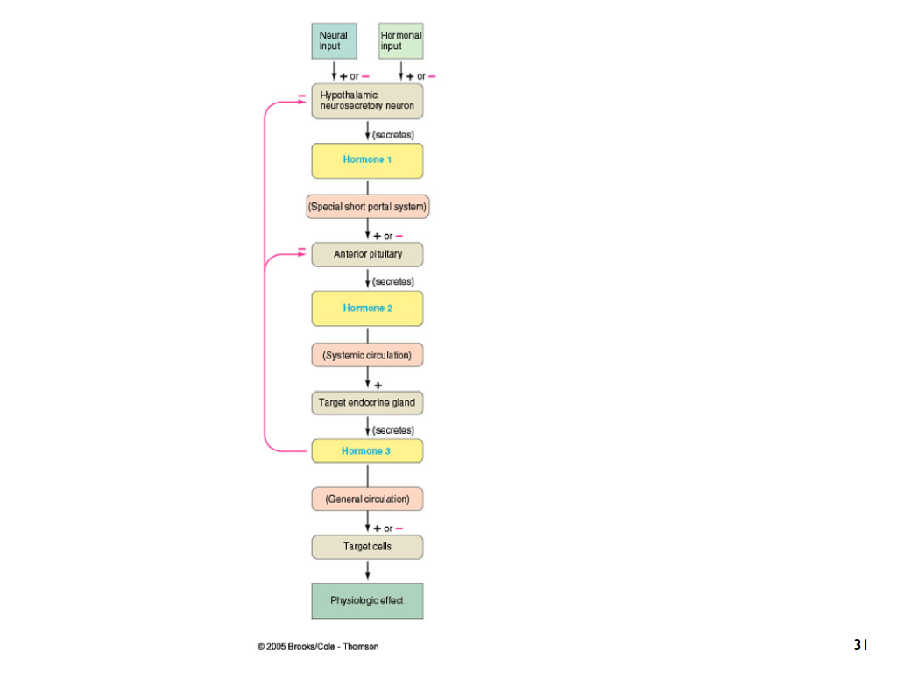

Slide 42
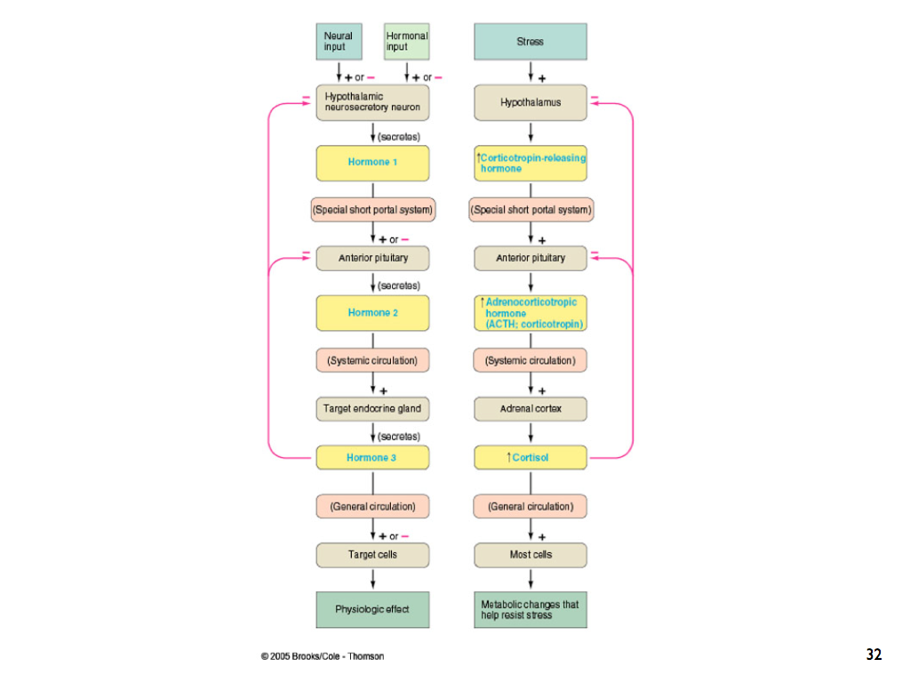

Slide 43
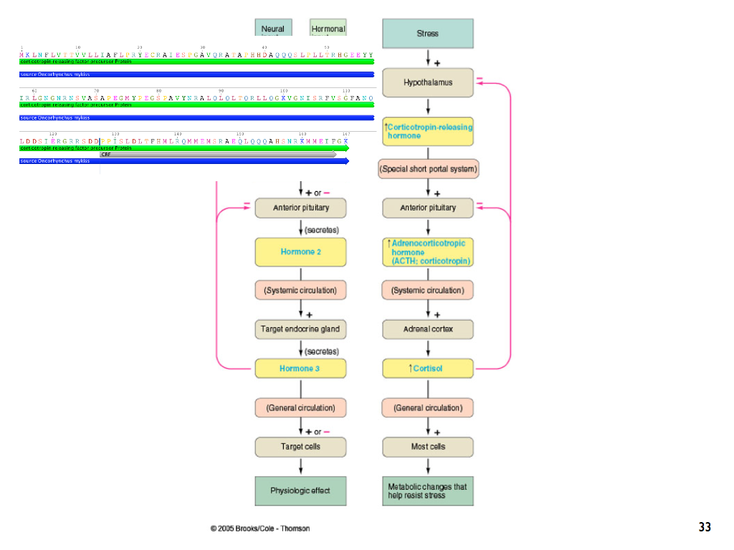

Slide 44
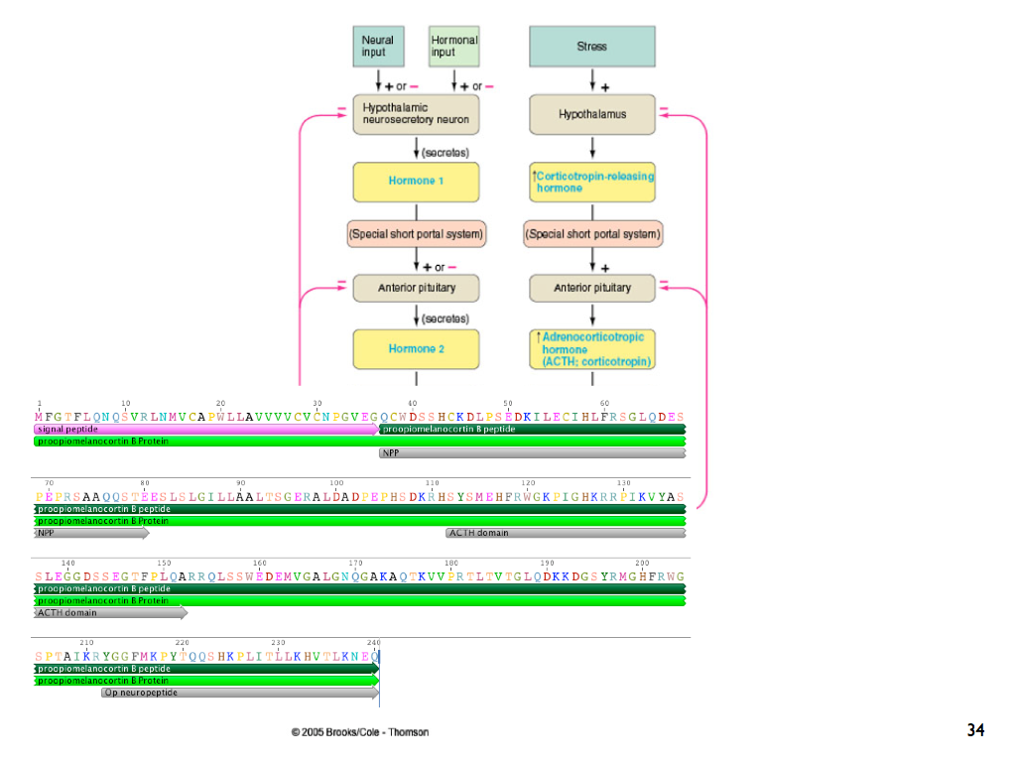

Slide 45
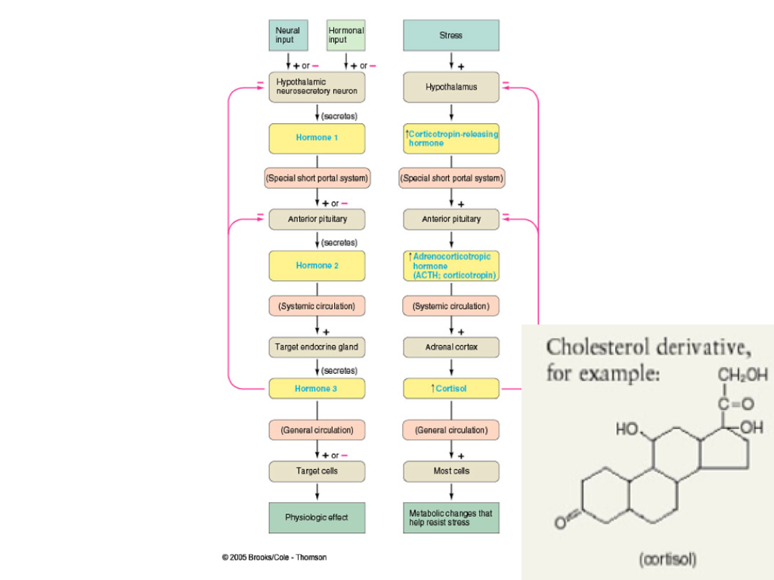

Slide 46
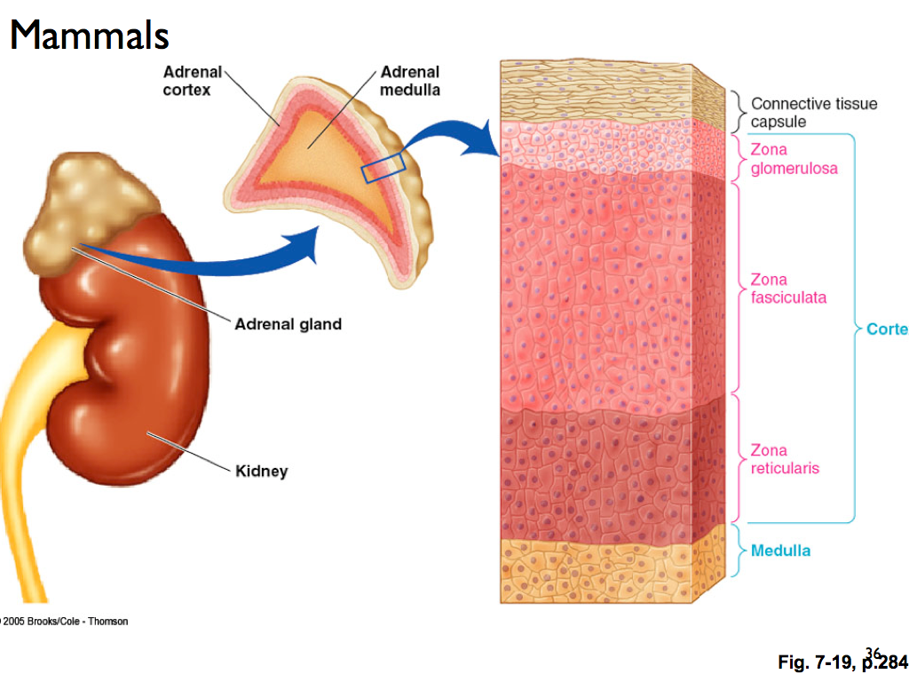

Slide 47
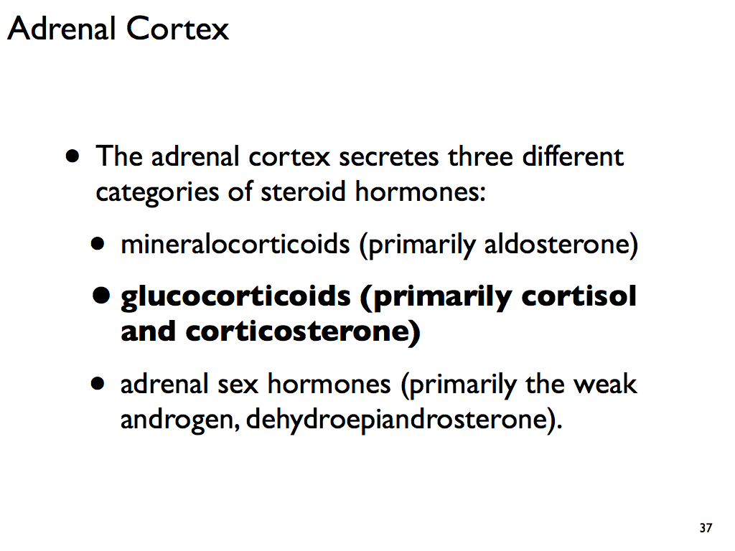

Slide 48
Aldosterone acts on the distal tubules increasing reabsorption of ions and water in the kidney, to cause the conservation of sodium, secretion of potassium, increase in water retention

Slide 49
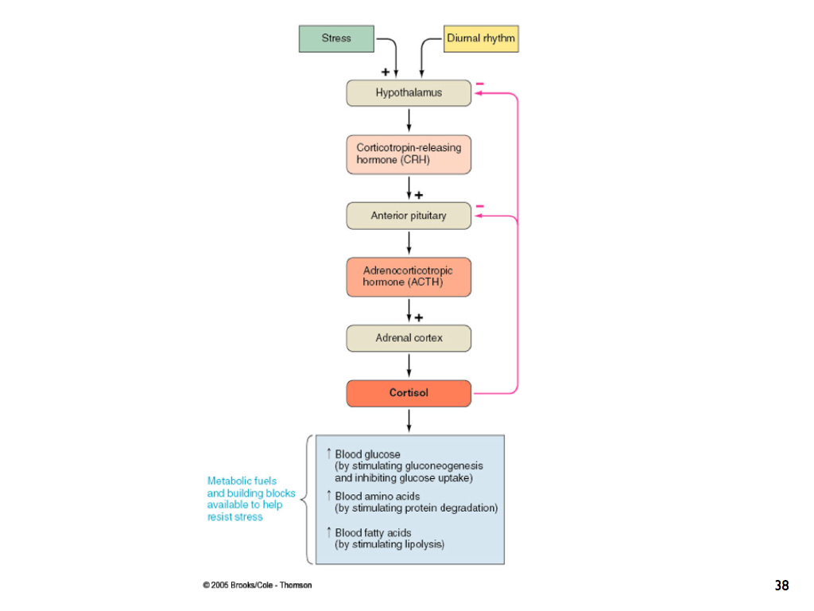

Slide 50
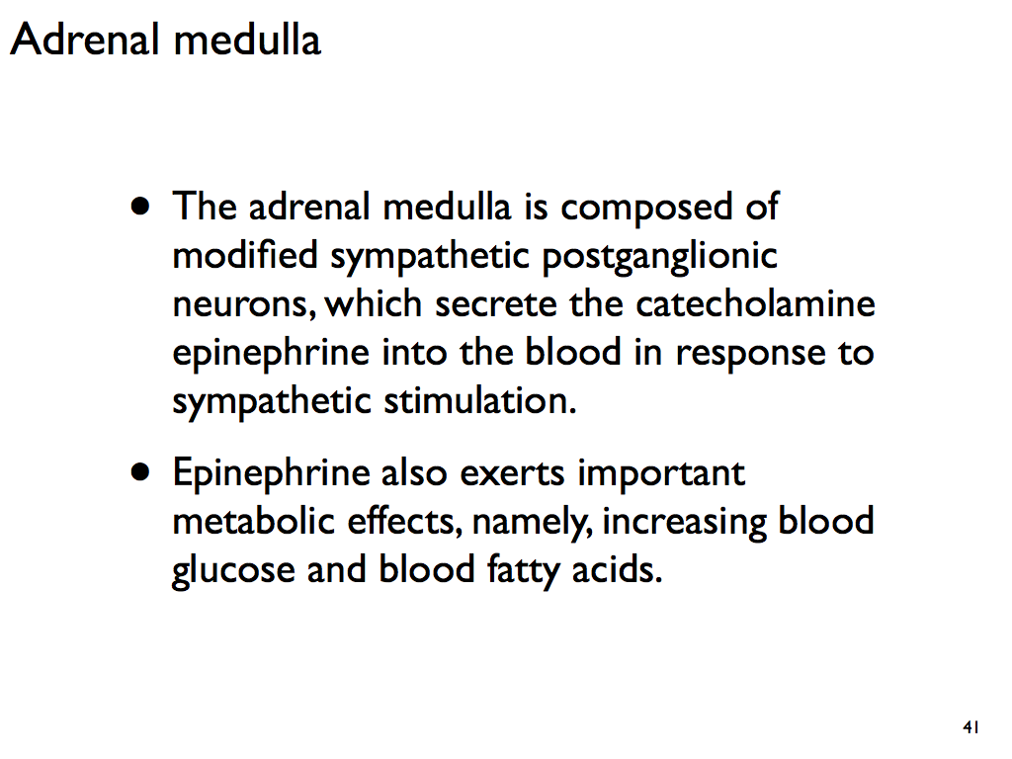

Slide 51
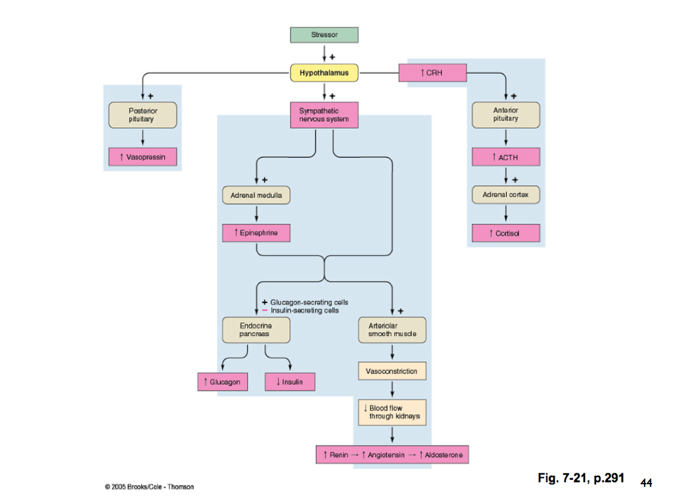

Slide 52
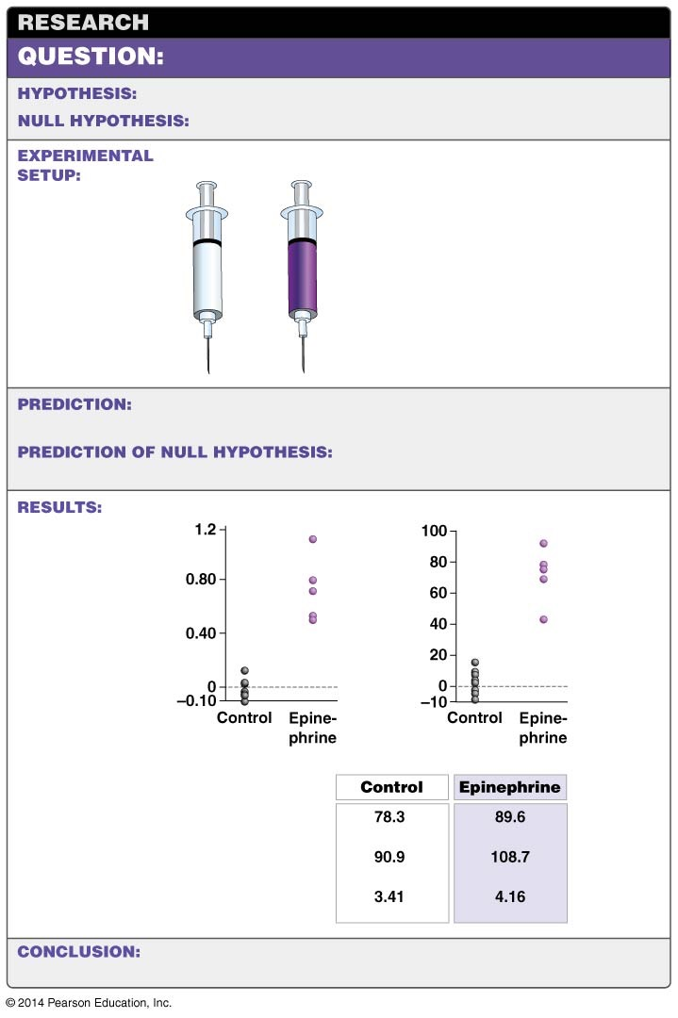
Figure 49.9
How does epinephrine affect the body?
Epinephrine causes changes involved it the fight-or-flight response.
Epinephrine is not involved it the fight-or-flight response.
Control
Epinephrine
1. Inject human
volunteers with
saline solution or
epinephrine.
2. Document changes
in fatty-acid and glucose
concentrations in blood,
pulse rate, blood
pressure, and oxygen
consumption in brain.
Saline
solution
Epinephrine increases fatty-acid and glucose concentrations in blood,
pulse rate, blood pressure, and brain oxygen consumption relative to controls.
individuals based on molecule injected.
No differences in physiological state of
Change in free fatty-
acid concentration
in blood (mEq/L)
Percent change in glucose
concentration in blood
Pulse rate
(beats/min)
Blood pressure
(average, mm Hg)
O₂ consumption in brain
(cc O₂/100 g/min)
fight-or-flight response.
Epinephrine causes an array of changes associated with the
Notes:
Figure 49.9 Epinephrine Prepares the Body for Action.

Slide 53
How Cortisol Controls Blood Sugar in Humans
Cortisol manages three processes for the maintenance of glucose production:
Cortisol induces the liver to produce enzymes that generate glucose from amino acids
Cortisol changes adipose tissue and resting muscles resistant to insulin so they will not take in glucose
It promotes the release of fatty acids for use by the heart and muscles

Slide 54
How Cortisol Controls Blood Sugar in Humans
In humans, this hormone ensures a constant supply of glucose to the brain
The overall effect is that requirements of the brain are met while other tissues and organs become expendable

Slide 55
How Are Hormones Involved in Homeostasis?
In homeostatic systems, messages often travel from integrators to effectors in the form of hormones. Homeostasis involves the following:
Sensory receptors monitor conditions relative to a set point
An integrator processes information from the sensor
Effector cells return the condition to the set point

Slide 56
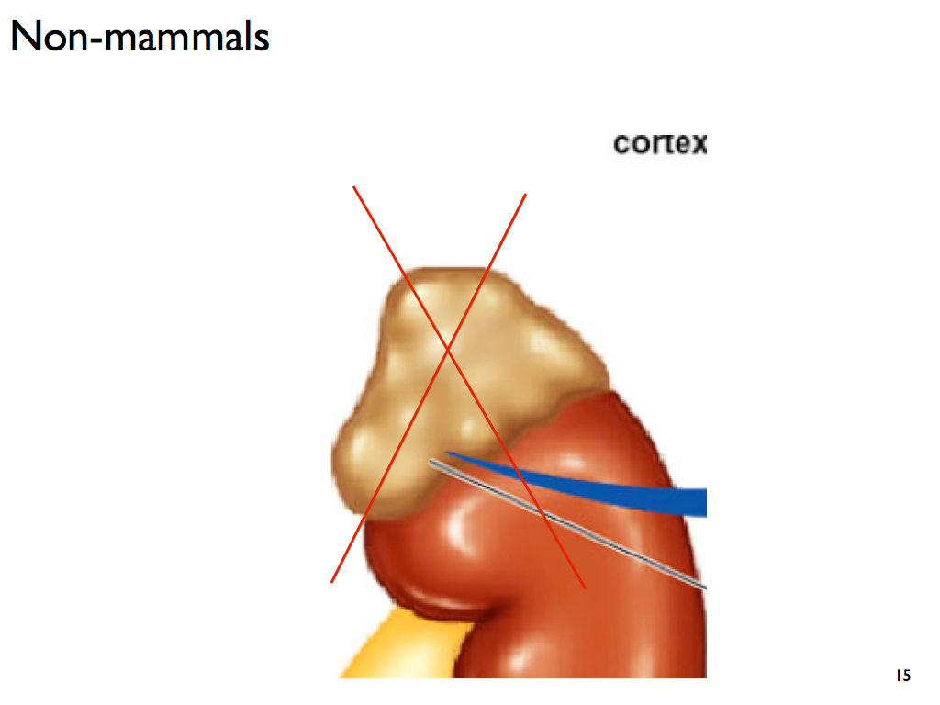

Slide 57
How Are Hormones Involved in Homeostasis?
Animals keep energy reserves in the form of triglycerides because large quantities of ATP can be produced from them
The triglycerides are found in fat bodies of insects and adipose tissue of mammals
This is one example of a homeostatic system

Slide 58
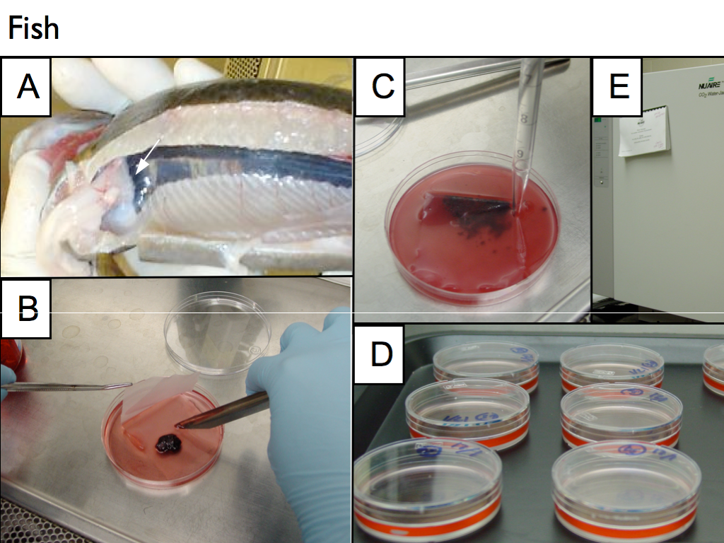

Slide 59
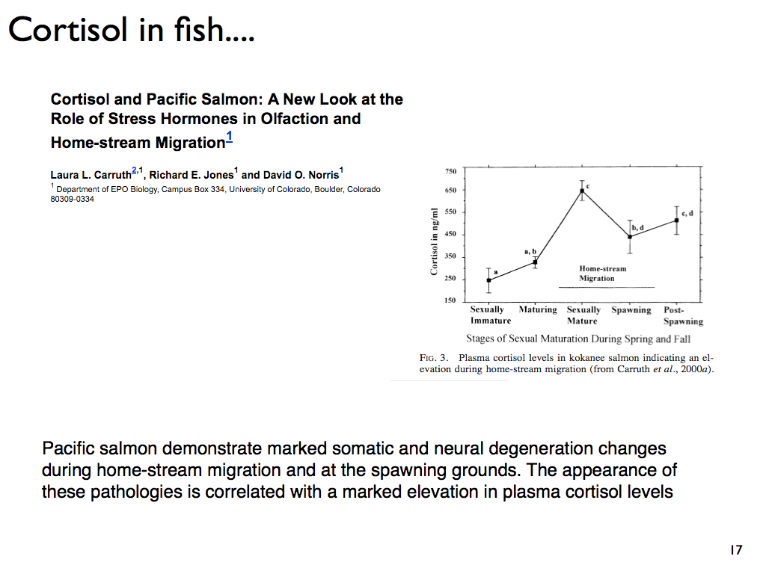

Slide 60
